Slide 1

N O R M A L I Z E
B l a c k W e a l t h
through financial education
F³ Academy
FAITH FAMILY FINANCE
www.f3academy.online

Slide 2
Series Agenda
August 31, 2025 Money Mindset
September 7, 2025 Money Concepts & Principles
September 14, 2025 Insurance – Why It’s Under-utilized to Build Wealth
September 21, 2025 Love Insurance with Living Benefits
September 28, 2025 Debt Reduction / Credit / Funding
October 5, 2025 Asset Classes / Estate Planning 101 October 12, 2025 Investing (Advanced Classes Available)
October 19, 2025 Summary – Project Reports

Slide 3
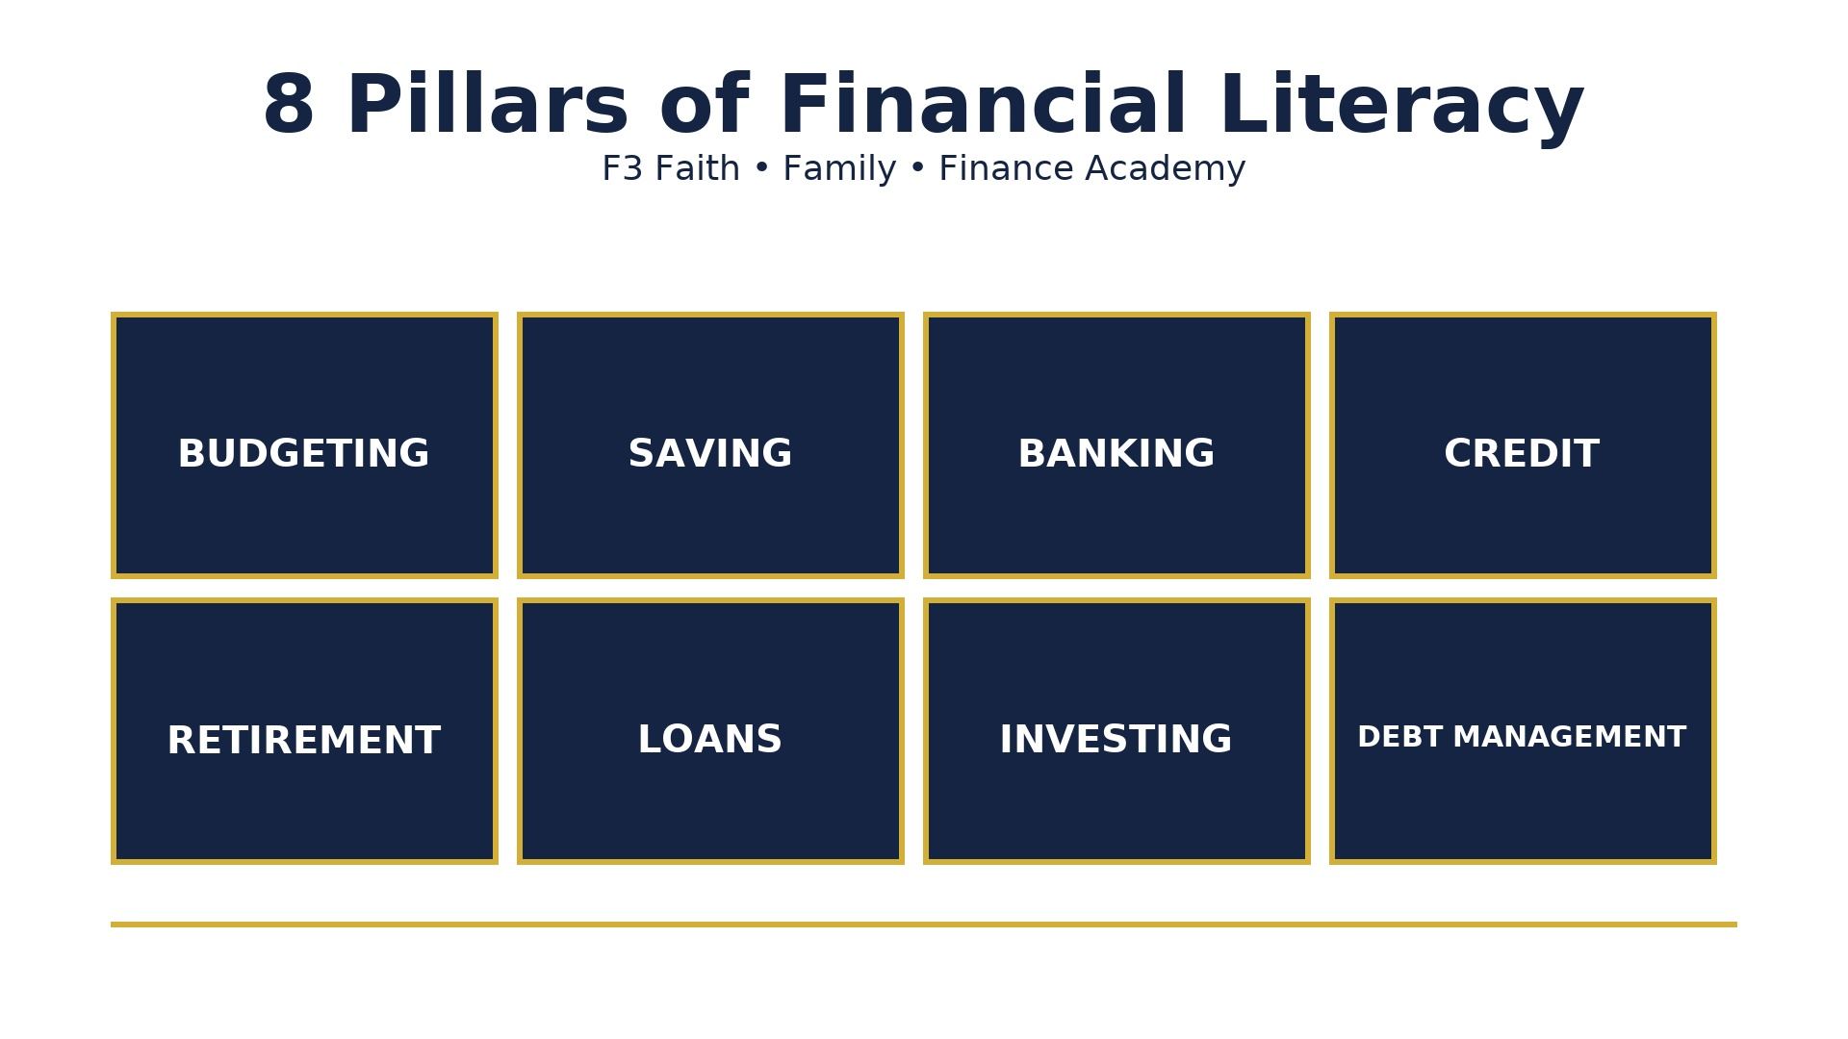

Slide 4

How Money Works

Slide 5
YouTube University
Easy Flow
Wealth Twins
Jaspreet Sighn
Money Mindset
Christine Ibbotson
Ask the Money Lady
Steve
Call to Leap – former school teacher
Melanin Money
Carter Cofield
George Archeampong
Corporate
Les Jenkins
Anthony O’Neal
The Table w/ Anthony O’Neal
Courtney Hale
@supermoneycourt
Myron Golden
Trash Man to Cash Man
Terrii Ijeoma
Trade and Travel
Cultural
Wallstreet Trapper
Smart Money Bro
Earn Your Leisure Podcast
& University
Nischa – former investment banker
Tiffany James
Modern Black Girl

Slide 6
Q & A
Wrap Up

Slide 7
Session 2
Money Principles & Practices
…….
‘Grow Your Mind…Grow Your Money’

Slide 8
YouTube University
Easy Flow
Wealth Twins
Jaspreet Sighn
Money Mindset
Christine Ibbotson
Ask the Money Lady
Steve
Call to Leap – former
school teacher
Melanin Money
Carter Cofield
George Archeampong
Church/Corporate
Les Jenkins
Anthony O’Neal
The Table w/ Anthony O’Neal
Courtney Hale
@supermoneycourt
Myron Golden
Trash Man to Cash Man
Terri Ijeoma
Trade and Travel
Cultural
Wallstreet Trapper
Smart Money Bro
Earn Your Leisure Podcast
& University
Nischa – former investment banker
Tiffany James
Modern Black Girl

Slide 9
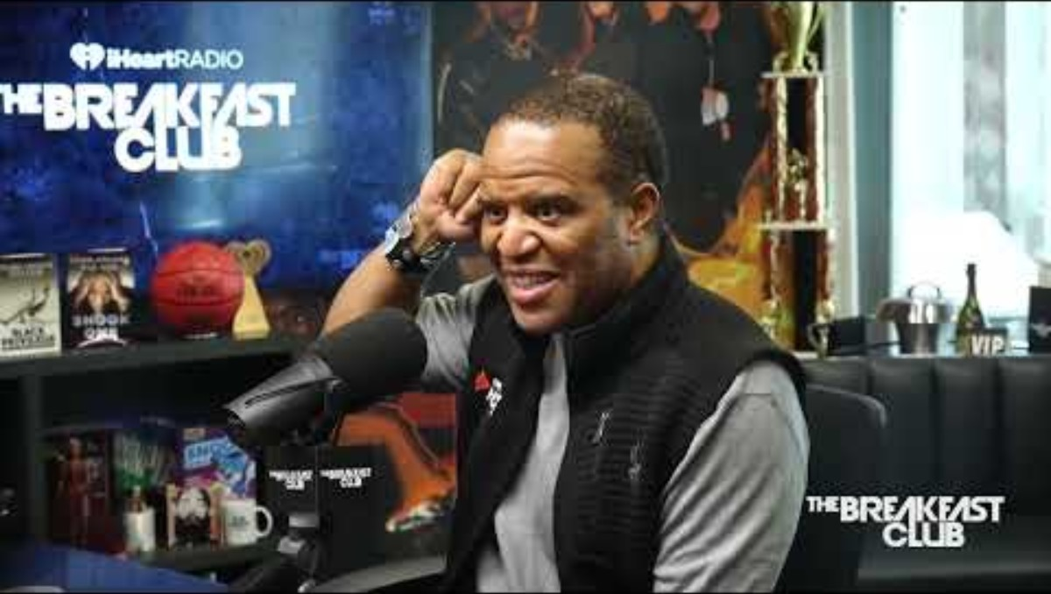
How Money Works:
Principles for Building Wealth

Slide 10
Which Do You Choose?
$1,000,000 one-time payment
or
$.01 cent doubled for 30 days
Life will always be about choices.
Choose you this day, whom you will serve.
As for me and my house, will serve the Lord.
Joshua

Slide 11
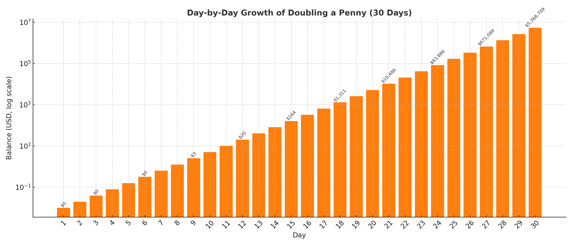

Slide 12
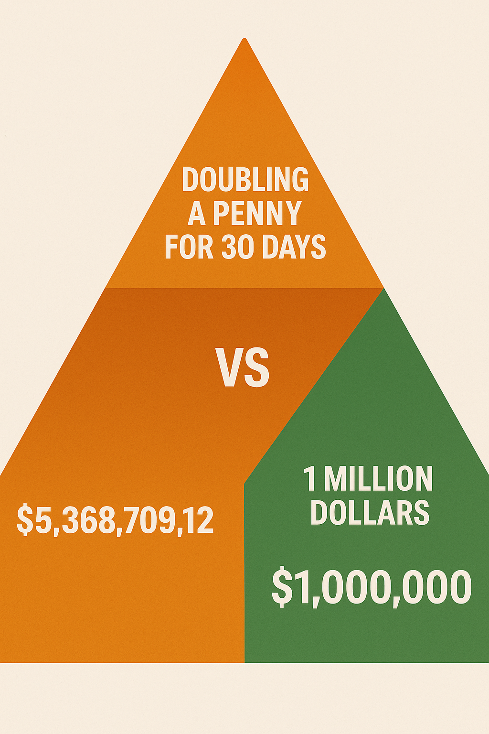
Homework
Chart the daily value of a penny doubling for 30 days

Slide 13
Why Financial Literacy Matters
Principle: Money is a tool, not a master.
Most people work for money, but money should work for you.
Lack of financial knowledge leads to debt, stress, and missed opportunities.

Slide 14
Money Principle #1
Pay Yourself First – Save before you spend.
Put rules on YOUR money.
Assign it.
Pay yourself first.
Pay yourself with interest.
Put aside a portion for investing.
Live below your means. (75% of take home)

Slide 15
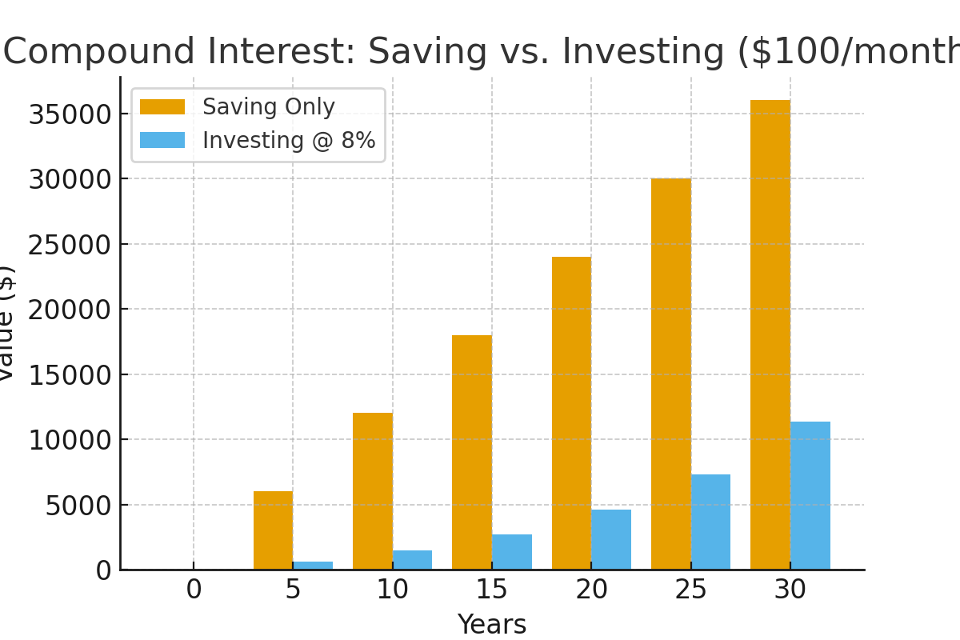
Money Principle #2
Compound Interest -
Money growing on top of money.
Example: $100/month at 8% for 30 years = $149,000+
Visual: Side-by-side bar chart of saving vs. investing with growth.

Slide 16
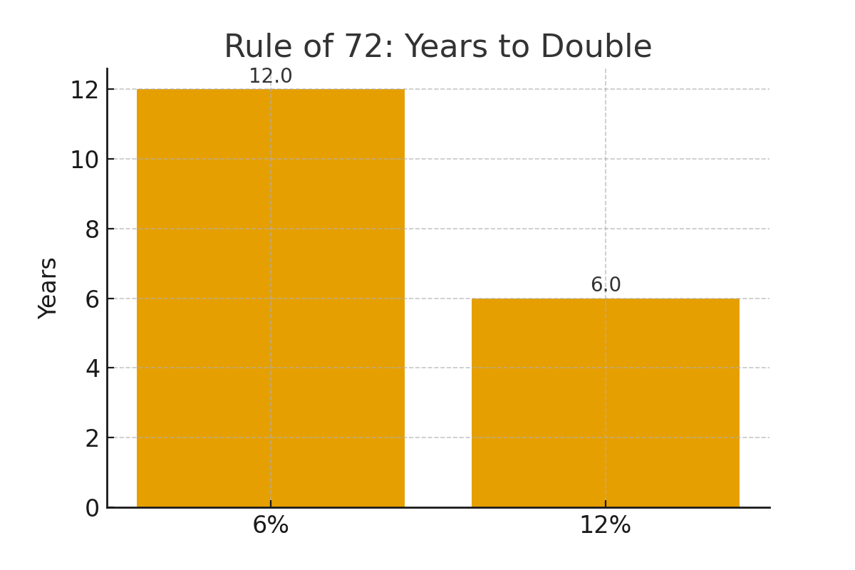
Money Principle #3
Rule of 72 –
Time it takes for money to double
(72 ÷ rate of return)

Slide 17
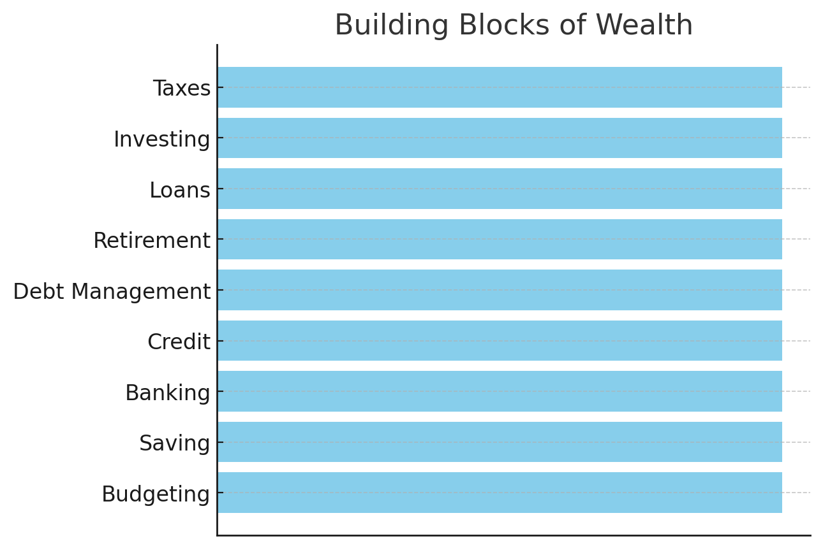
Money Principle #4
Good Debt vs. Bad Debt –
Borrowing to invest vs. borrowing to consume.

Slide 18
NACA – Neighborhood Assistance Corporation of America
ELIMINATING BARRIERS TO AFFORDABLE HOMEOWNERSHIP
NACA provides over 30% of all the housing counseling in the country and is the most effective in providing affordable long-term homeownership for both homebuyers and homeowners. NACA’s transformative mortgage product, counseling services, and character-based underwriting provides a model for how fair mortgage lending can successfully be made a reality for working families and people of color on a large scale.
Below Market Fixed Rate
No down payment
No closing costs
No fees
No mortgage insurance
No consideration of credit score

Slide 19
Q & A
Wrap Up

Slide 20
Series 3
Insurance: Myths and Fallacies
Why Is Insurance Under-utilized
In Building Wealth?

Slide 21

INSURANCE
What does all types of insurance coverage have in common?

Slide 22
Definition
Insurance is a contract (called a policy) in which you pay money (called a premium) to an insurance company, and in return, the company promises to protect you financially against certain risks.
Main Purpose
Insurance is all about risk management. Instead of bearing all the risk yourself, you share it with many other people through the insurance company. You pay premiums to the insurance, in return, the insurance company agrees to take on the risk that if a covered event happens, you will be made whole.

Slide 23
How Insurance Works
Step 1
You pay premiums
Step 2
A covered event happens
Step 3
You file a claim
Step 4
Insurance company cuts you a check

Slide 24
Two Types of Insurance
Term Life Insurance
Definition: Provides coverage for a specific period of time (e.g., 10, 15, 20, or 30 years).
Purpose: Pays a death benefit to your beneficiaries if you pass away during that term.
Cost: Most affordable option, since it’s pure insurance without extra savings features.
Best For:
  Families who need protection while kids are growing up.
  Covering a mortgage, debts, or income replacement during working years.
Downside:
  If the term ends and you’re still alive, coverage stops (unless you renew, often at higher cost).
  No cash value or savings component.
Permanent =

Slide 25
Two Types of Insurance
Permanent Life Insurance
Definition: Provides coverage for your entire lifetime, as long as premiums are paid.
Types: Includes Whole Life, Universal Life, Variable Life, and Indexed Universal Life (IUL).
Cash Value: Builds a savings component (cash value) that grows tax-deferred and can be borrowed against.
Cost: Premiums are higher than term because of lifetime coverage and cash accumulation.
Best For:
  Estate planning and wealth transfer.
  People who want lifetime coverage plus a savings/investment element.
  Business owners funding buy-sell agreements or key-person insurance.
Downside:
  More complex and expensive.
  Requires long-term commitment to realize benefits.

Slide 26
Myths vs the Reality of Life Insurance
Myth/Fallacy | Reality
Life insurance is only for burial expenses | Covers debt, income replacement, education, legacy
It is too expensive to afford | Term life can be affordable, especially when young
I am young and healthy, so I don’t need it | Buying early locks in lower premiums and higher coverage
My job’s insurance is enough | Work policies are limited (term) and end when you leave job
I don’t need life insurance without kids | Covers debt and secure future insurability without kids
Insurance companies don’t pay out | Over 98% of claims are paid; denials are rare
I can’t get coverage because of my health | Many companies now offer policies for people with health conditions (like diabetes or high blood pressure), sometimes at higher premiums but still accessible.

Slide 27
30M Americans are underinsured
37M have no life insurance
WHY?
We have been misinformed.
Why These Myths Persist in the African American Community
Historical mistrust:
Historically, African Americans were discriminated against by most insurers (e.g., being charged higher rates or denied coverage, or lower coverage).
Lack of financial literacy outreach:
Many communities haven’t had equal access to financial education, so myths persist.
Cultural traditions:
Good time on the frivolous and ignore what is priority. Pass the buck and leave the burden on others.

Slide 28
US 2020 Census Snapshot
(census.gov) From the 2020 U.S. Census (official data as of April 1, 2020)
331,449,281 as of April 1, 2020
Race / Ethnicity | Share of Total U.S. Population
White alone, non-Hispanic | 57.8%
Hispanic or Latino (of any race) | 18.7%
Black or African American alone, non-Hispanic | 12.1% 30M (3.6M) 37M (4.44M)
Asian alone, non-Hispanic | ≈ 5–6 %) — exact number not always cited in short data summaries
Other races (including American Indian & Alaska Native, Native Hawaiian & Other Pacific Islander, and people of two or more races) | Remainder (~ 6–7 %)

Slide 29
What Banks Don’t Want You To Know
While they pay you minimal interest on your deposit into a
High Yield Savings account, they in turn invest in
Bank Owned Life Insurance (BOLI) contracts,
therefore, yielding 200 – 400% of your deposit.
Account Type | Typical APY / Rate
Regular (national average) savings account | ~ 0.61% APY Bankrate
Top high-yield savings accounts | Around 4.00% to 5.00% APY

Slide 30
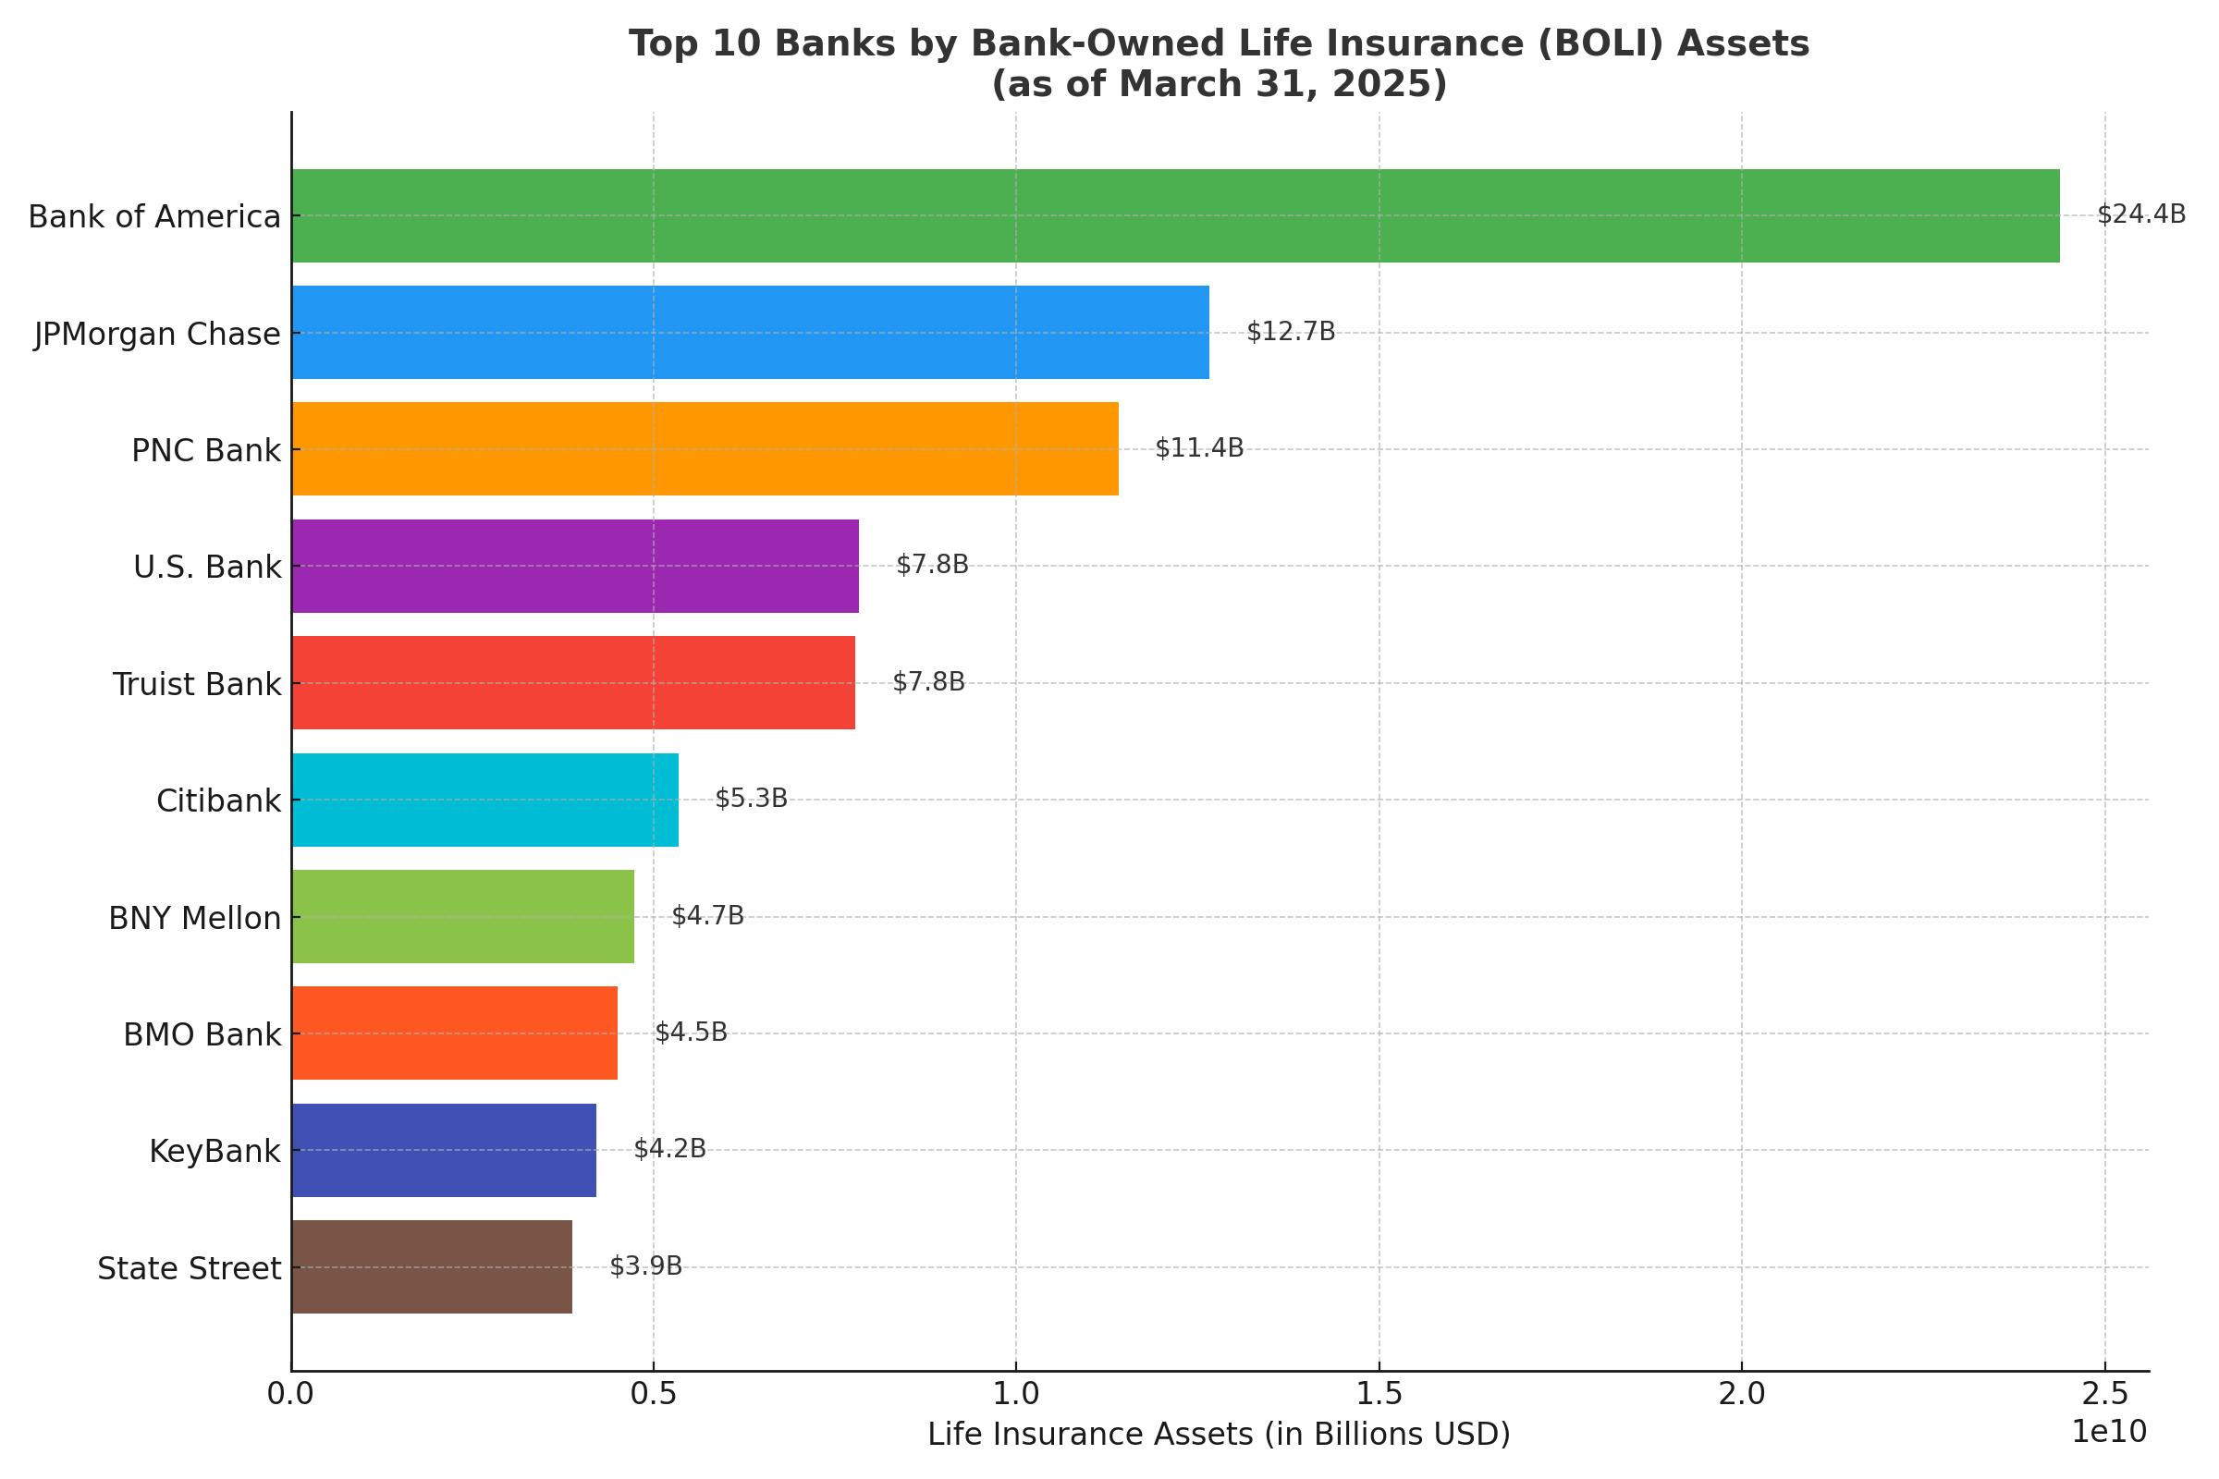

Slide 31
How to Determine the Adequate Amount
of Protection Needed
D I M E Theory
D = Debt
I = Income (10 x)
M = Mortgage
E = Education
Debt + 10x Income + Mortgage + Education = $Insurance Amount$

Slide 32

Become Your Own Bank

Slide 33
The Roby-Watkins Family Trust
Policy 1 – Son $250 $500,000.00
Policy 2 – Daughter $55 $500,000.00
Grandchild 1 $50 IUL $400,000.00
Grandchild 2 $50 IUL $400,000.00
Grandchild 3 $50 IUL $400,000.00
Grandchild 4 $50 IUL $400,000.00
Total Insurance Protection $2,600,000.

Slide 34
Q & A
Wrap Up

Slide 35
Series 4
Review
Why Is Insurance Under-utilized
In Building Wealth?

Slide 37
NACA
Neighborhood Assistance Corporation of America
www.naca.com
Classes begin next Sunday
6:00pm – 6:55pm CST
Wealth building using Real Estate

Slide 38


Slide 39
More Money Principles
1. Keep your Money - Zero % Tax Bracket
2. Grow your Money without Losing - Zero Loss Index Strategy
3. Guarantee your Money - Lifetime Income
4. Protect your Money - Living Benefits & Life Insurance

Slide 40
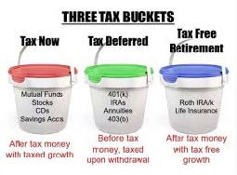
Keep Your Money
How you’re taxed dictates how much of your
money you get to keep.

Slide 41
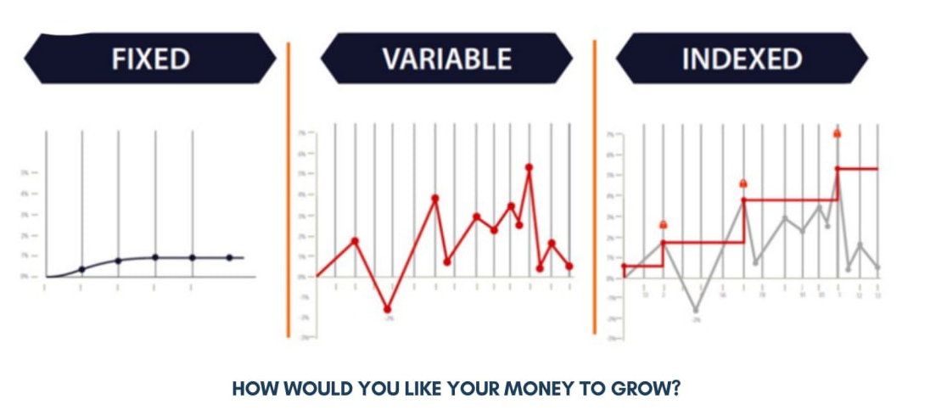
Grow Your Money
Your interest credit strategy dictates how fast you
grow your money.

Slide 42
Guarantee Your Money
How much do you need to make sure you do not outlive your money at retirement?
Lifetime Income vs. Lump Sum
$500,000 at retirement, if you withdraw $40,000/year,
you will outlive your money in 12.5 years
If you have $500,000 at retirement that has a Guaranteed Lifetime Income of $40,000/year, you will never outlive your money!

Slide 43
Protect Your Money
Average Cost of Long-Term Care is $89,000/year in a semiprivate nursing home
No 1 cause of bankruptcy in the US is medical bills: heart attack, stroke, cancer
Qualify for living benefits and permanent life insurance without depending on your employer
Product = IUL Index Universal Life contract

Slide 44
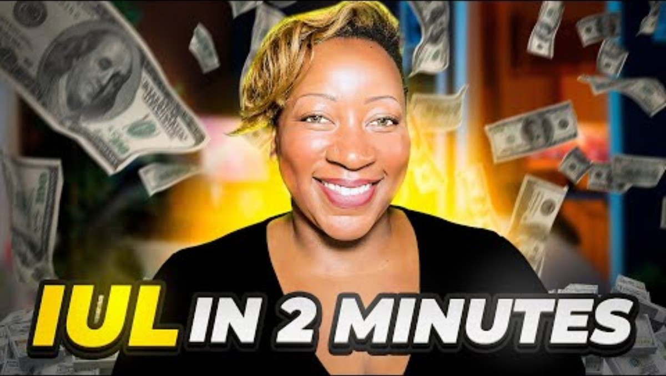

Slide 45
What Are Living Benefits?
Traditional life insurance only pays out at death.
Living Benefits allow policyholders to access part of the death benefit while they’re still alive if they face certain qualifying events.
This makes life insurance a financial protection tool for both life and death.
Qualifying Events:
Living Benefits can typically be triggered by:
Chronic Illness – Inability to perform 2 out of 6 Activities of Daily Living such as cooking, feeding, bathing, dressing, transferring, and continence.
Critical Illness – Conditions such as heart attack, stroke, cancer, or organ transplant.
Terminal Illness – Physician diagnosis of life expectancy of 12–24 months or less (varies by carrier).

Slide 46
How They Work
Policyholders may accelerate a portion of their death benefit (sometimes up to 80–90%) to cover expenses.
Funds are tax-advantaged in many cases (consultation with tax advisor is advised).
Money can be used for medical bills, living expenses, mortgage payments, business continuity, or caregiving support.
Flexibility of Use
Unlike health insurance, there are usually no restrictions on how the money is spent.
Clients may use it to:
  Maintain their household income
  Pay for experimental treatments not covered by insurance
  Cover long-term care needs
  Provide financial relief for family caregivers
Protection for Families & Businesses
Families – Prevent financial devastation during health crises.
Business Owners – Protect against loss of income, ensure continuity, and provide cash flow during recovery.

Slide 47
Exercise
Paycheck Payout
Where is your money going every payday?

Slide 48
Q & A
Wrap Up

Slide 49
YouTube Video Links
Class 1: Do These 7 Things In Your 40s To Retire A Millionaire In Your 50s
Class 2: John Hope Bryant Talks 'Financial Literacy For All,' Operation HOPE, U.S. DEI, Credit Freedom + More
Class 3: How To Use Life Insurance AS YOUR BANK (What Your Agent Won't Tell You)
How Life Insurance Can Skyrocket Your Wealth - Kandi's Story
Rockefeller’s Wealth Hack: Trusts That Multiply Your Money!
Class 4: Stop Paying Debt Wrong - (1663) The TRUTH About Paying Off Your Debt Banks Don’t Want You to Know! – YouTube

