Slide 1

Our aim is to help normal people build real wealth without gambling or chasing the latest get rich quick scheme.
We will teach simple money principles, smart money habits, and long-term strategies so you can grow your net worth with confidence—even if you’re starting late or feel left behind.
N O R M A L I Z E
F a m i l y W e a l t h
through financial education
F³ Academy
FAITH FAMILY FINANCE

Slide 2




MONEY NEEDS A MISSION
“Every dollar needs an assignment
before it disappears.
Principle: Budgeting gives your money
direction. Discipline builds your savings.
Meeting ID: 849 495 5811
Passcode: 052923

Slide 3
SPEND LESS THAN YOU EARN
“Financial freedom begins when your income
is greater than your lifestyle.”
Principle: Living below your means creates room to save, invest, and give.
Series Agenda
June 14, 2026 Money Mindset, Concepts, and Principles
June 21, 2026 Insurance – Why It’s Under-utilized to Build Wealth
Creating the ILIT – Irrevocable Life Insurance Trust
June 28, 2026 Debt Reduction / Credit / Real Estate / Funding
July 5, 2026 No Class – Homework Assignment – Paycheck
July 12, 2026 Estate Planning 101
July 19, 2026 Investing (Advanced Classes Available)
July 26, 2026 Summary / Next Steps / Project Reports

Slide 4
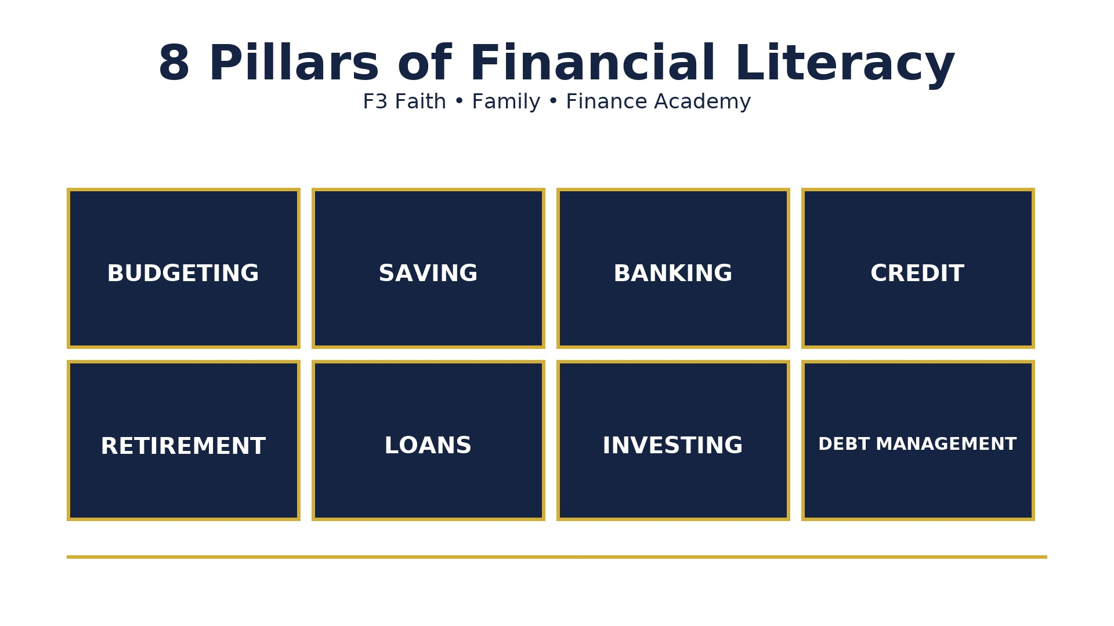
PAY YOURSELF FIRST
“Before you pay bills, build the habit of paying your future.
Principle: Saving should be treated like
a line-item expense in your budget.
The goal of financial literacy
is to understand these concepts foundationally.
Do you adhere to a monthly budget?
What percent of your paycheck goes to savings?
How well do you understand how banks make money?
Credit is always short term. Pay balance before the next cycle to avoid interest.
What will it take monetarily for you to retire comfortably?
Build family wealth by paying back loans to your family bank.
It is never too late to start investing. What are your investing strategies?
Debt management must be intentional. What tools do you use to help you stay on track?

Slide 5
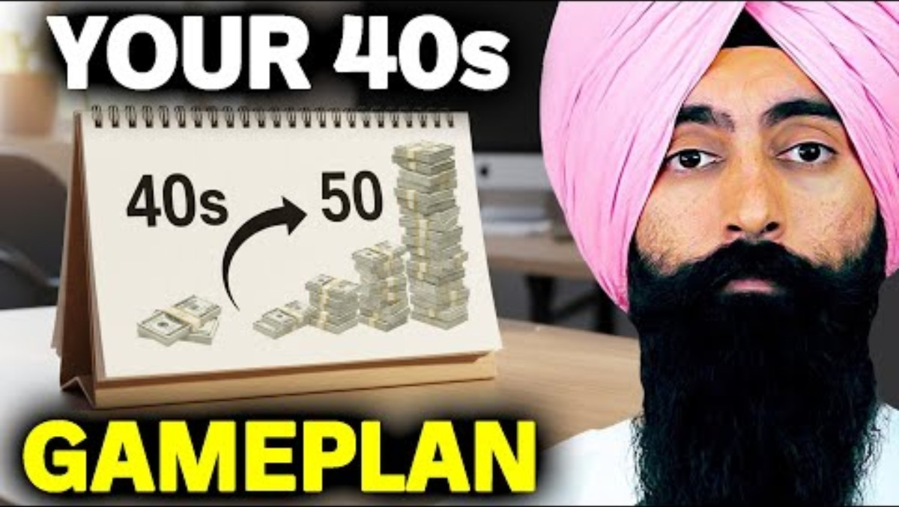
SMALL HABITS BUILD WEALTH
“Wealth is rarely built by one big decision; it is built by repeated wise decisions.”
Principle: Consistency matters more than styling and profiling.
How Money Works
393168

Slide 6
DEBT STEALS TOMORROW’S INCOME
“Borrowed money may solve today’s problem, but it can limit tomorrow’s choices.”
Principle: Debt should be carefully
used and paid down intentionally.
YouTube University
Easy Flow
Wealth Twins
Jaspreet Sighn
Money Mindset
Christine Ibbotson
Ask the Money Lady
Steve Chen
Call to Leap – former school teacher
Melanin Money
Carter Cofield
George Archeampong
Corporate
Les Jenkins
Anthony O’Neal
The Table w/ Anthony O’Neal
Courtney Hale
@supermoneycourt
Myron Golden
Trash Man to Cash Man
Terrii Ijeoma
Trade and Travel
David Retires
Retirement Risk Report
Cultural
Wallstreet Trapper
Smart Money Bro
Earn Your Leisure Podcast
& University
Nischa – former investment banker
Tiffany James
Modern Black Girl

Slide 7
EMERGENCY FUNDS PROTECT DREAMS
“An emergency fund keeps a setback
From becoming a disaster.”
Principle: Cash reserves protect
you from debt, stress, and worry.
Wrap Up
Q & A

Slide 8
PROTECT WHAT YOU BUILD
“Financial wisdom includes saving, growing,
and protecting what God has entrusted to you.”
Principle: Insurance, estate planning, and
proper documents protect families.
Session 2
Money Principles & Practices
…….
‘Grow Your Mind…Grow Your Money’

Slide 9
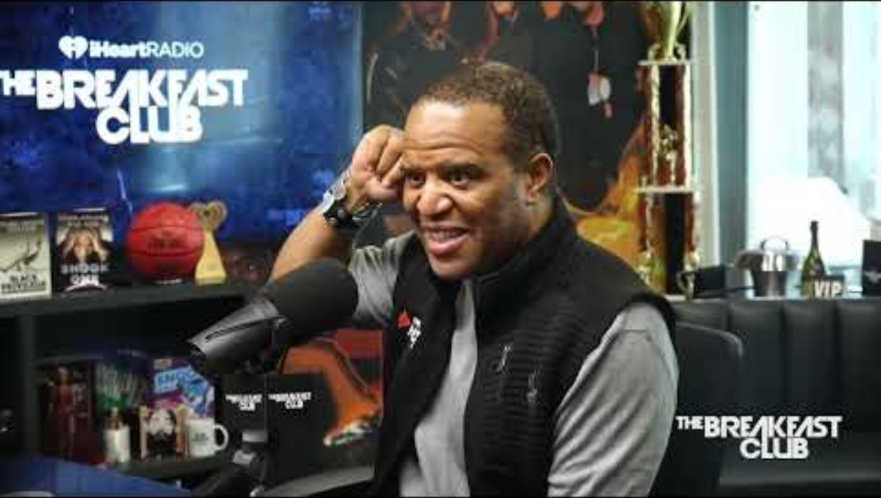
GENEROSITY IS PART OF STEWARDSHIP
“Money is not just for spending,
it is also a tool for serving.”
Principle: Giving teaches purpose,
discipline, and legacy.
How Money Works:
Principles for Building Wealth

Slide 10
Principle: How much you earn matters, but how much you keep and grow matters more.
A person can earn $100,000 and still be broke if they spend it all. Wealth is created by ownership, savings, investing, and disciplined stewardship.
Which Do You Choose?
$1,000,000 one-time payment
or
$.01 cent doubled for 30 days
Life will always be about choices.
“Choose you this day, whom you will serve.
As for me and my house, we will serve the Lord.”
Joshua 24:15

Slide 11
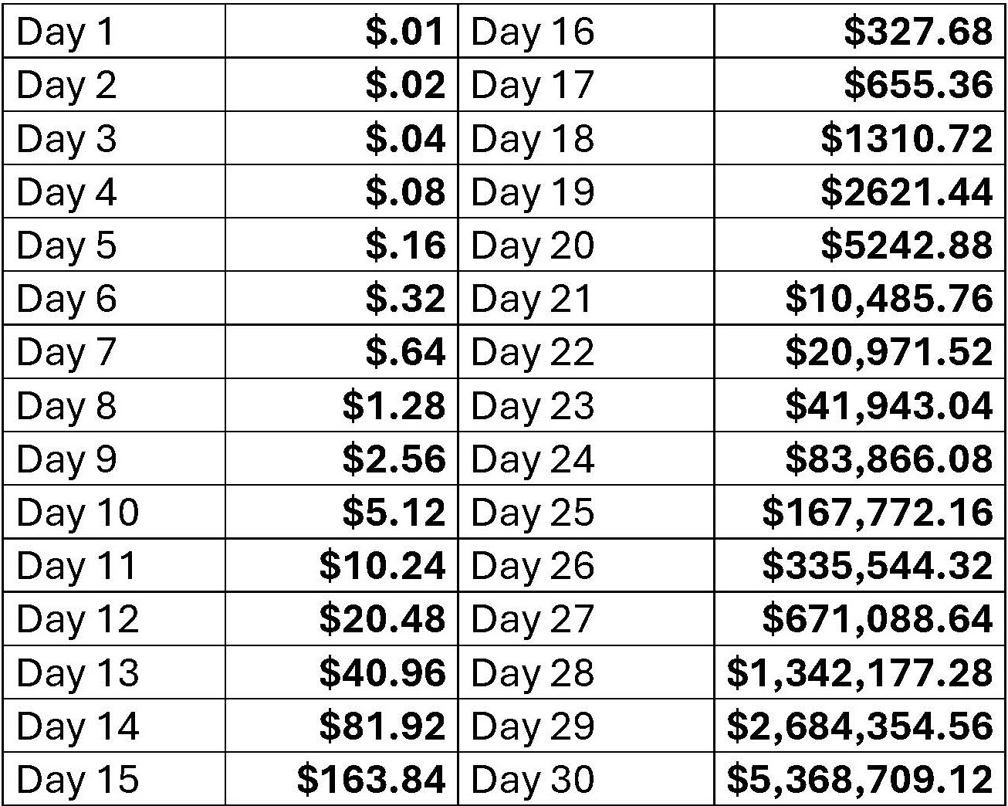
Principle: As income increases, expenses often increase too.
When people get raises, promotions, bonuses, or tax refunds, they often upgrade spending instead of upgrading savings and investments.
Double Down – A Penny Doubled for 30 Days

Slide 12
Money Principles from Session 1
Money is a tool which allows you to get wealth.
Deuteronomy 8:18
Put rules on YOUR money. Assign it a purpose.
Pay yourself first – Save before you spend.
Live below your means. (75% of take home) Apply the 75/15/10 rule
Today, we want to introduce the principles of:
Pay yourself with interest.
Put aside a portion for investing.

Slide 13
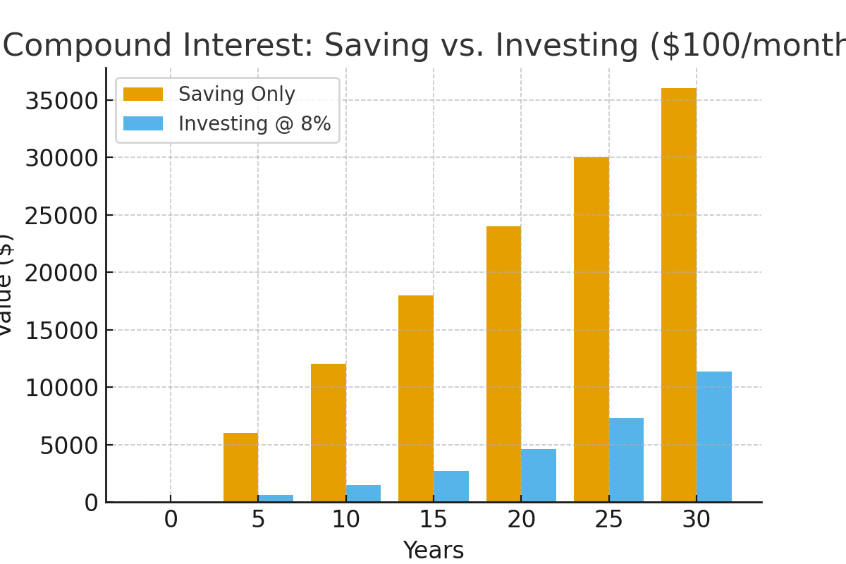
Money Principle #1
Compound Interest -
Money growing on top of money.

Slide 14
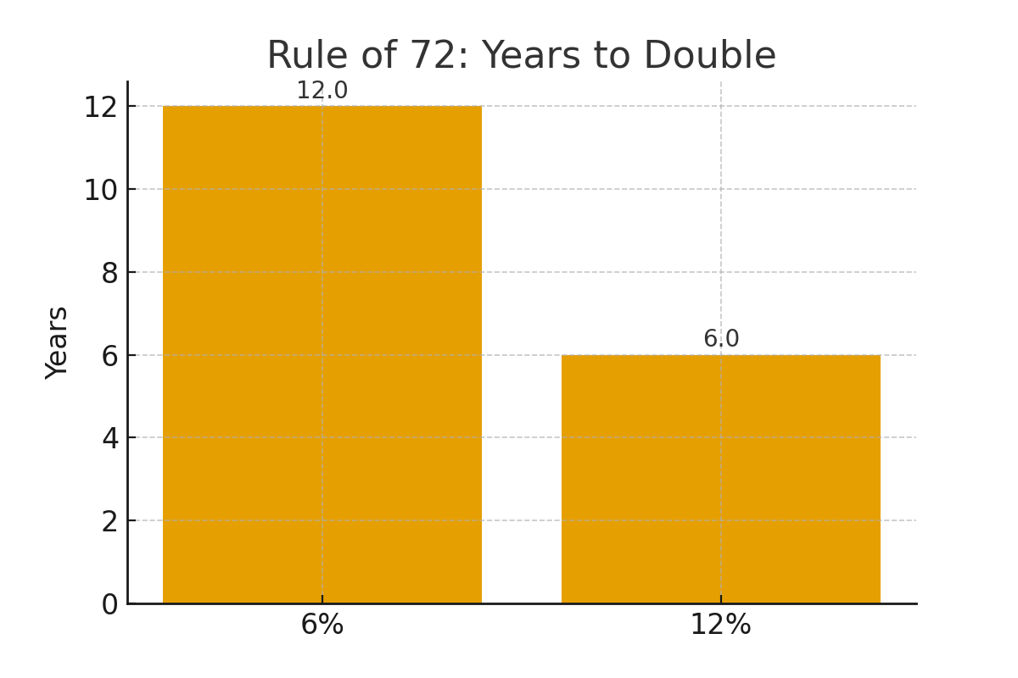
Money Principle #2
Rule of 72 –
Time it takes for money to double
(72 ÷ rate of return)

Slide 15
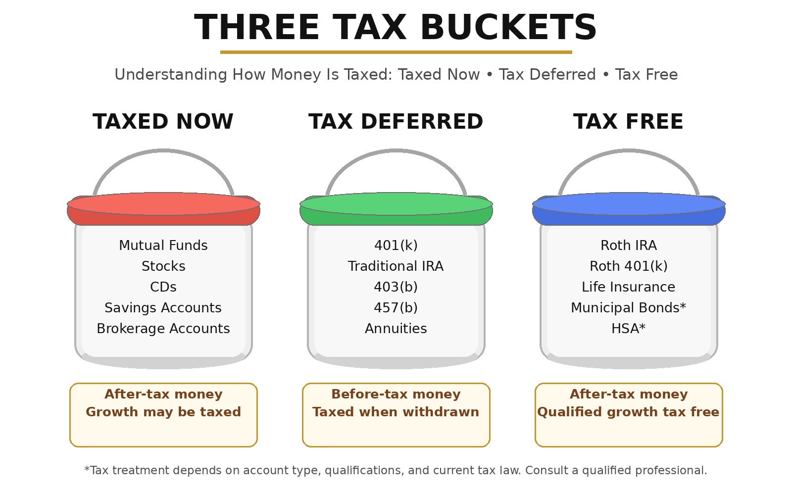
Money Principle #3
How Money Is Taxed

Slide 16
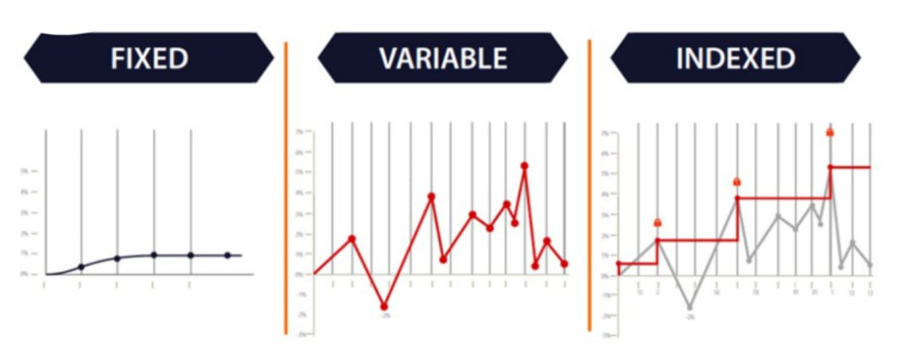
Principle: Money grows best when time is on its side.
The earlier someone starts saving and investing, the less they may need to contribute later because time does part of the work.
Money Principle #4
How Interest Is Credited
Fixed at contract rate
agreed upon
Subject to market volatility; upside gains, downside losses
Subject to market volatility; upside gain, zero floor losses

Slide 17
INVEST EARLY, EVEN IF IT’S SMALL
“Time is the most powerful partners
your money can have.”
Principle: Compound interest rewards growth early and consistent investing.
Compounding Interest Over 20 Years
Step 1. Save $250 per month = $3,000 annually
Step 2. Save $3000.00 per year for 20 years = $60,000
Step 3. $60,000 (savings) will grow to $100,000 over 20 years with avg 10% return
Step 4. Applying the Rule of 72 – divide 72 by the rate of return paid in interest, equals the number of years it will take to double your money
Step 5. 72 / 10 = 7.2 years
Step 6. Begin at age 25. 25 – 45, saving $3000.00 per year
Step 7. Age 45 – 52; $100,000 doubles to $200,000
Step 8. Age 53 – 60; $200,000 doubles to $400,000
Step 9. Age 61 – 68; $400,000 doubles to $800,000
Step 10. Age 69 – 76; $800,00 doubles to $1.6million

Slide 18
Wrap Up
Q & A

