Slide 1
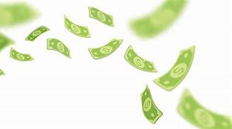
N O R M A L I Z E
B l a c k W e a l t h
through financial education
F³ Academy
FAITH FAMILY FINANCE
www.f3academy.online

Slide 2
Series Agenda
August 31, 2025 Money Mindset
September 7, 2025 Money Concepts & Principles
September 14, 2025 Insurance – Why It’s Under-utilized to Build Wealth
September 21, 2025 Love Insurance with Living Benefits
September 28, 2025 Debt Reduction / Credit / Funding
October 5, 2025 Asset Classes / Estate Planning 101 October 12, 2025 Investing (Advanced Classes Available)
October 19, 2025 Summary – Project Reports

Slide 3
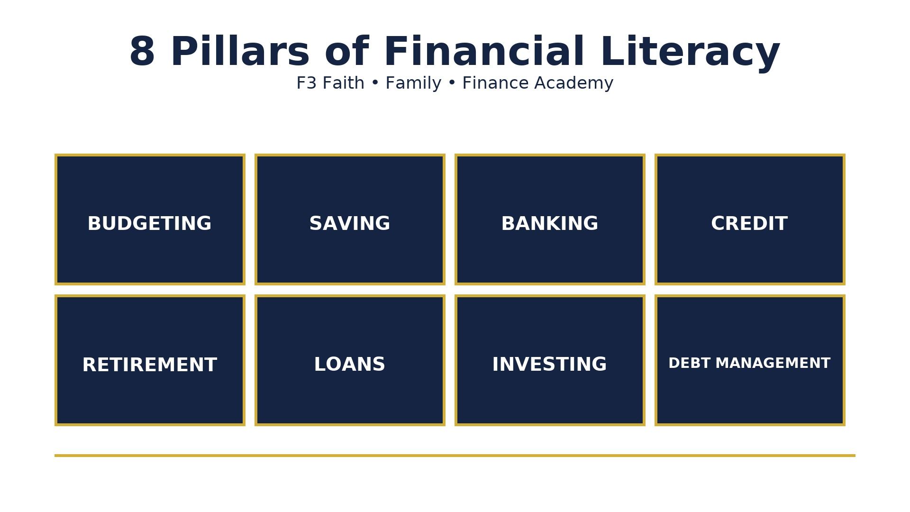

Slide 4
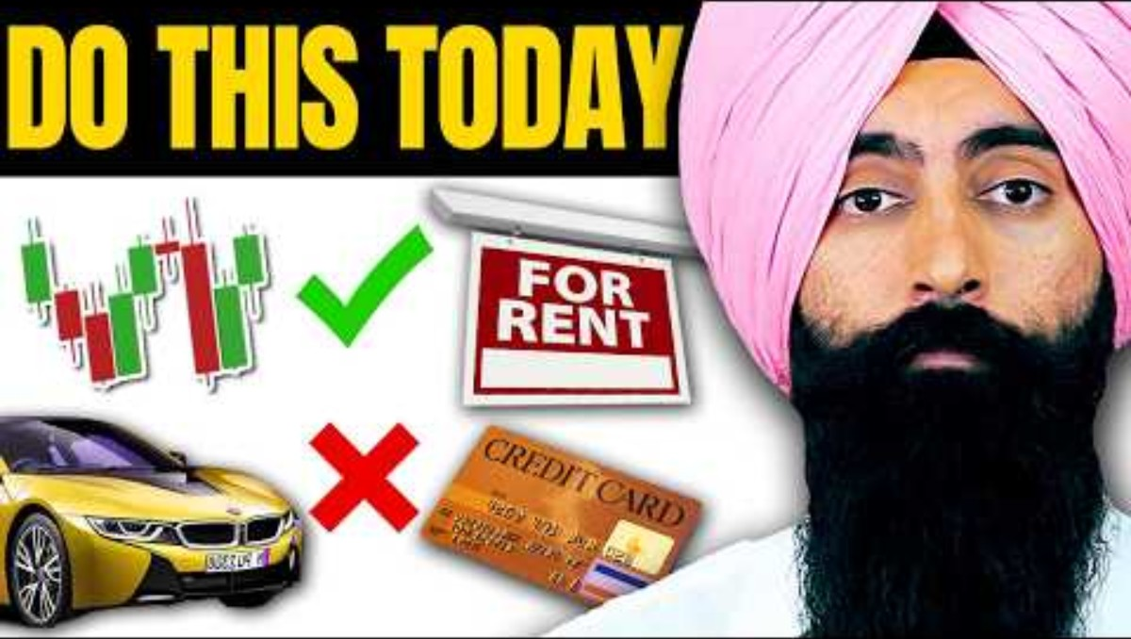
How Money Works

Slide 5
YouTube University
Easy Flow
Wealth Twins
Jaspreet Sighn
Money Mindset
Christine Ibbotson
Ask the Money Lady
Steve
Call to Leap – former school teacher
Melanin Money
Carter Cofield
George Archeampong
Corporate
Les Jenkins
Anthony O’Neal
The Table w/ Anthony O’Neal
Courtney Hale
@supermoneycourt
Myron Golden
Trash Man to Cash Man
Terrii Ijeoma
Trade and Travel
Cultural
Wallstreet Trapper
Smart Money Bro
Earn Your Leisure Podcast
& University
Nischa – former investment banker
Tiffany James
Modern Black Girl

Slide 6
Q & A
Wrap Up

Slide 7
Session 2
Money Principles & Practices
…….
‘Grow Your Mind…Grow Your Money’

Slide 8
YouTube University
Easy Flow
Wealth Twins
Jaspreet Sighn
Money Mindset
Christine Ibbotson
Ask the Money Lady
Steve
Call to Leap – former
school teacher
Melanin Money
Carter Cofield
George Archeampong
Church/Corporate
Les Jenkins
Anthony O’Neal
The Table w/ Anthony O’Neal
Courtney Hale
@supermoneycourt
Myron Golden
Trash Man to Cash Man
Terri Ijeoma
Trade and Travel
Cultural
Wallstreet Trapper
Smart Money Bro
Earn Your Leisure Podcast
& University
Nischa – former investment banker
Tiffany James
Modern Black Girl

Slide 9
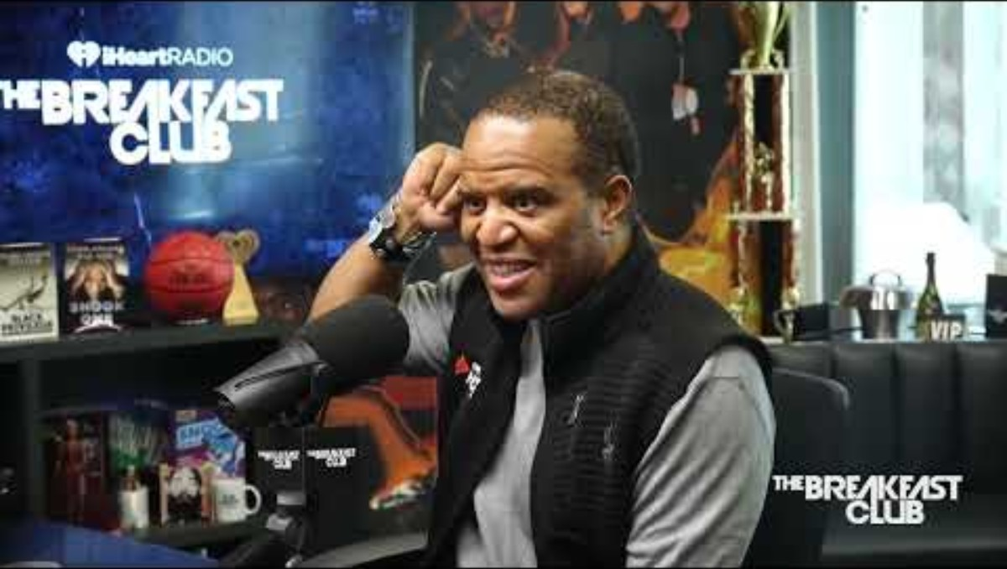
How Money Works:
Principles for Building Wealth

Slide 10
Which Do You Choose?
$1,000,000 one-time payment
or
$.01 cent doubled for 30 days
Life will always be about choices.
Choose you this day, whom you will serve.
As for me and my house, will serve the Lord.
Joshua

Slide 11
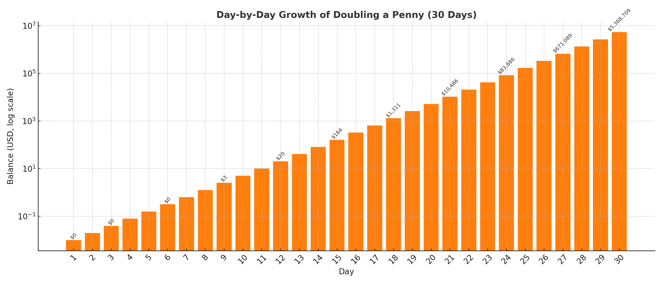

Slide 12
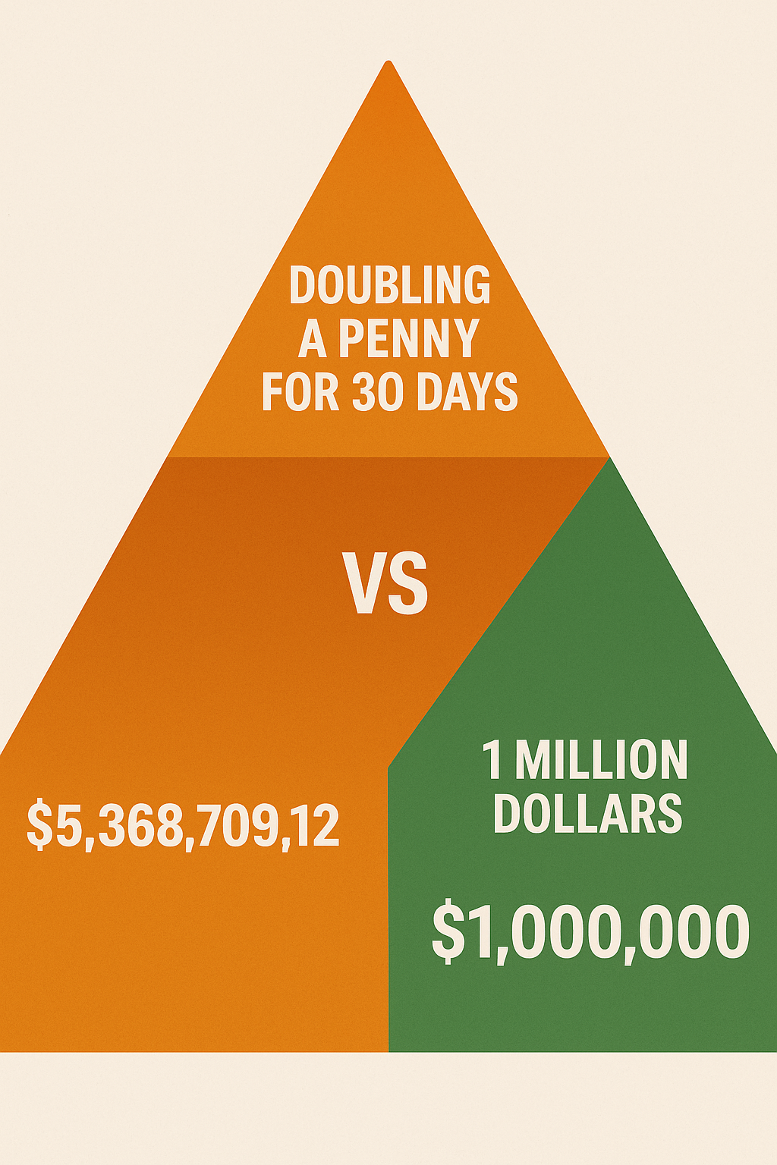
Homework
Chart the daily value of a penny doubling for 30 days

Slide 13
Why Financial Literacy Matters
Principle: Money is a tool, not a master.
Most people work for money, but money should work for you.
Lack of financial knowledge leads to debt, stress, and missed opportunities.

Slide 14
Money Principle #1
Pay Yourself First – Save before you spend.
Put rules on YOUR money.
Assign it.
Pay yourself first.
Pay yourself with interest.
Put aside a portion for investing.
Live below your means. (75% of take home)

Slide 15
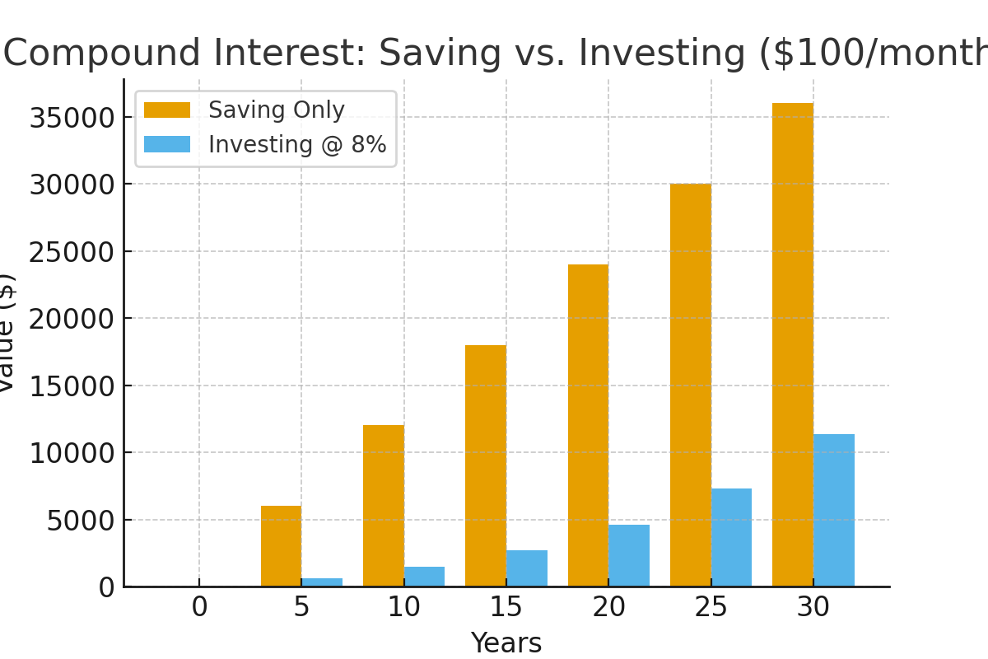
Money Principle #2
Compound Interest -
Money growing on top of money.
Example: $100/month at 8% for 30 years = $149,000+
Visual: Side-by-side bar chart of saving vs. investing with growth.

Slide 16
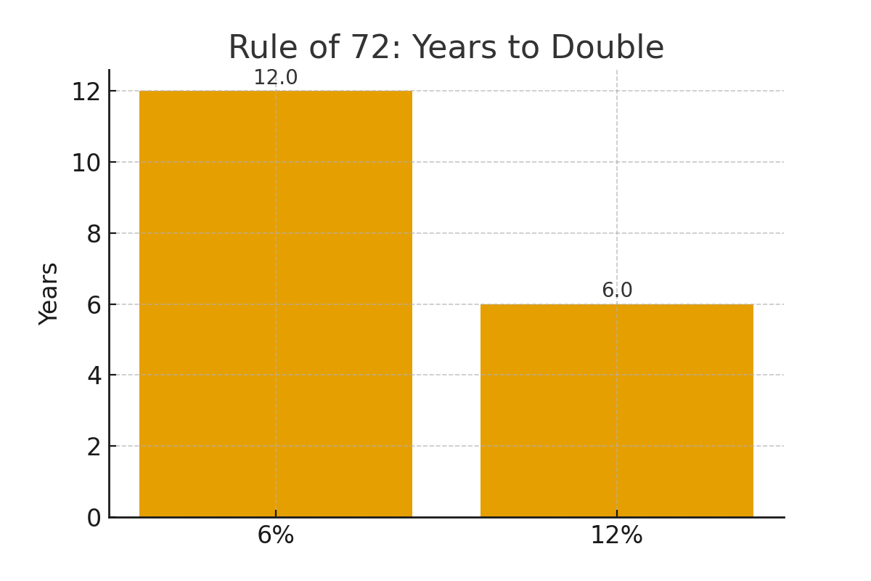
Money Principle #3
Rule of 72 –
Time it takes for money to double
(72 ÷ rate of return)

Slide 17
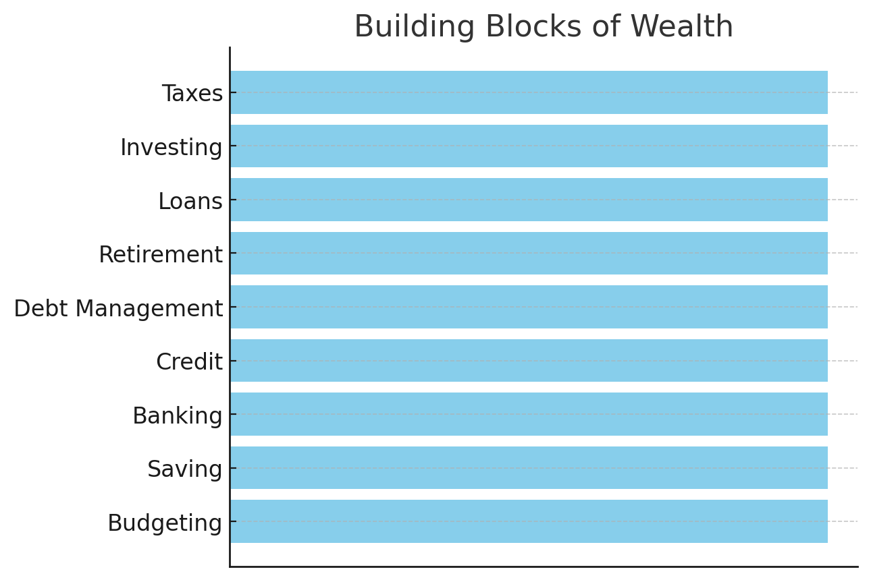
Money Principle #4
Good Debt vs. Bad Debt –
Borrowing to invest vs. borrowing to consume.

Slide 18
NACA – Neighborhood Assistance Corporation of America
ELIMINATING BARRIERS TO AFFORDABLE HOMEOWNERSHIP
NACA provides over 30% of all the housing counseling in the country and is the most effective in providing affordable long-term homeownership for both homebuyers and homeowners. NACA’s transformative mortgage product, counseling services, and character-based underwriting provides a model for how fair mortgage lending can successfully be made a reality for working families and people of color on a large scale.
Below Market Fixed Rate
No down payment
No closing costs
No fees
No mortgage insurance
No consideration of credit score

Slide 19
YouTube Video Links
Class 1: Do These 7 Things In Your 40s To Retire A Millionaire In Your 50s
Class 2: John Hope Bryant Talks 'Financial Literacy For All,' Operation HOPE, U.S. DEI, Credit Freedom + More
Class 3: How To Use Life Insurance AS YOUR BANK (What Your Agent Won't Tell You)
How Life Insurance Can Skyrocket Your Wealth - Kandi's Story
Rockefeller’s Wealth Hack: Trusts That Multiply Your Money!

Slide 20
Q & A
Wrap Up

